Slide 1
Is Graduate School worth it?
Anthony Beger & Jacob Haarala

Slide 2
Background
Is a graduate degree worth it? This is an important question to ask, because attending graduate school can come at a lofty price. According to Peterson’s, an educational service company, the average cost of tuition and fees for a master’s degree program at a public university is now close to $30,000. Therefore, we want to find the advantages of getting a graduate degree and show which industries benefit the most from a graduate degree.

Slide 3

Project goals
This project attempts to use Python to do a statistical and visual analysis of the benefits of getting a graduate degree and identify which industries/majors benefit the most from a graduate degree.
Implement the use of pandas, numpy, and stats packages to run descriptive statistics and find any statistical differences.
Implement the use of matplotlib and seaborn to create visuals that aid in our analysis.

Slide 4
Dataset
College Majors Dataset
All-ages.csv
Contains basic earnings and labor force information for 173 college majors.
Also contains a more detailed breakdown, including by sex and by the type of job they got.
Grad-students.csv
Contains basic earnings and labor force information for 173 graduate degrees.

Slide 5
reading in and transforming the data
Imported Python packages numpy, pandas, matplotlib, seaborn, and stats.
Used these packages to do our statistical and visual analyses in Python.
Used pd.read_csv() to read in both All-ages.csv and Grad-students.csv.

Slide 6
Analysis of median salary
The National Median Salary in 2020: $34,248.45
Average Median Undergraduate Salary: $ 58,583.82
Average Median Graduate Salary: $ 76,755.78
Workers with a Graduate degree make $ 18,171.97 more on average

Slide 7
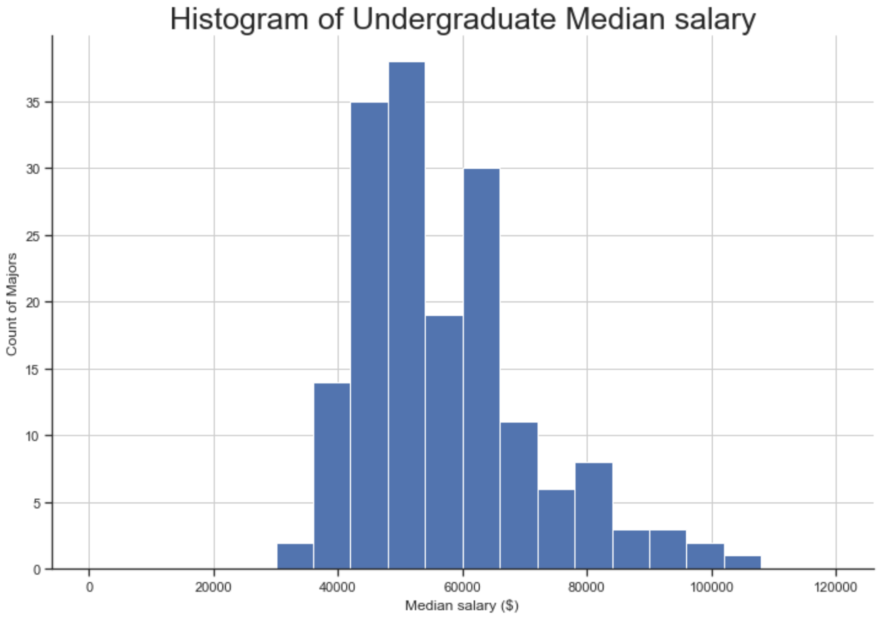
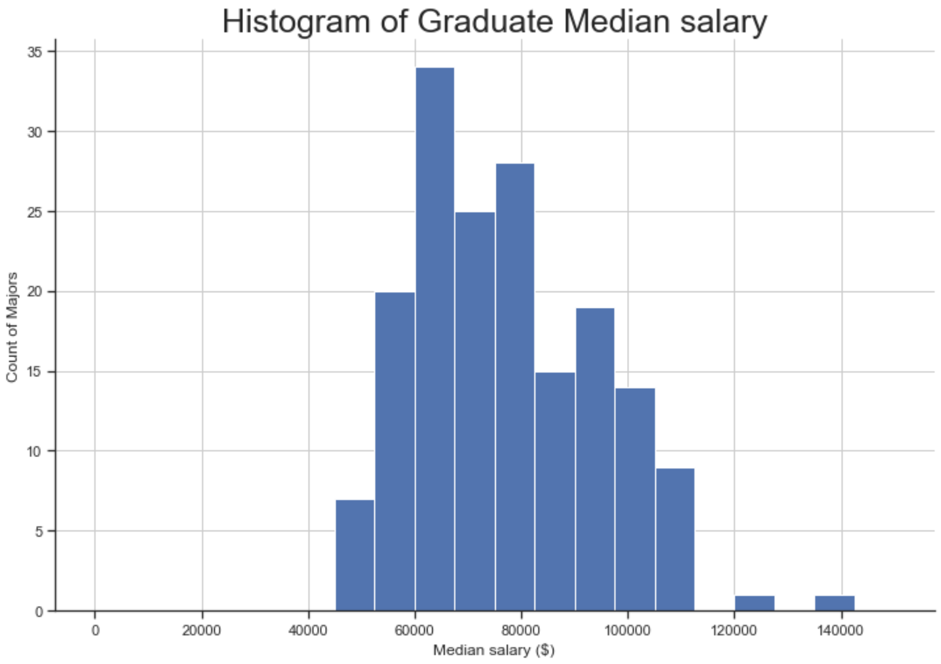
Analysis of median salary

Slide 8
Hypothesis Testing
Run a paired samples t-test on the equality of means
Null Hypothesis: µ1 = µ2, or the average median salaries are equal
Alternative Hypothesis: µ1 ≠ µ2, or the average median salaries are not equal
Alpha level: 0.05
First, we must check the paired samples t-test assumptions that the distribution of the two groups follows a normal distribution

Slide 9
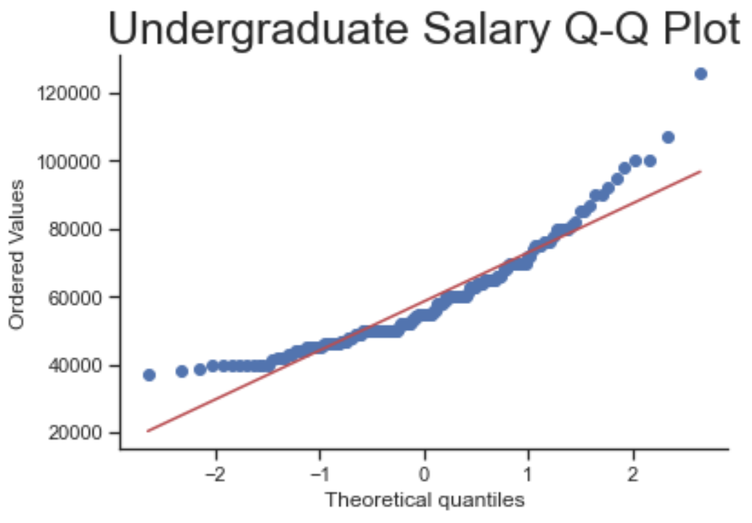
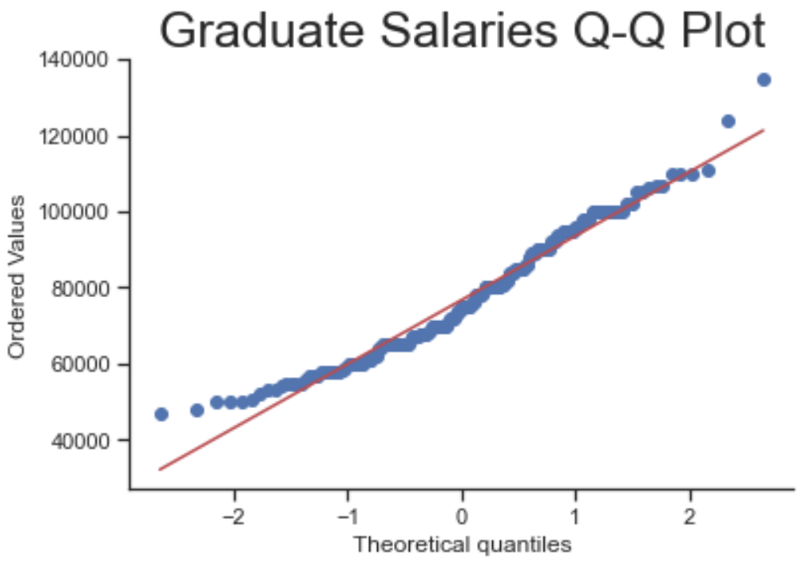
Check for normality

Slide 10
Running the paired t-test
Used stats.ttest_rel() from the stats package in Pyhton
P-value = 0.000
Since the p-value is less than the selected alpha level of 0.05, we reject the null hypothesis, and we can conclude that there is a statistically significant difference in the average median salaries earned by workers with a graduate degree and those with just an undergraduate degree.

Slide 11
Analysis of unemployment rate
National Unemployment Rate in 2020 was 8.31%
The average Undergraduate Unemployment Rate is 5.74%
The average Graduate Unemployment Rate is 3.93%
The average Undergraduate Unemployment Rate is 1.81% higher than the average Graduate Unemployment Rate

Slide 12
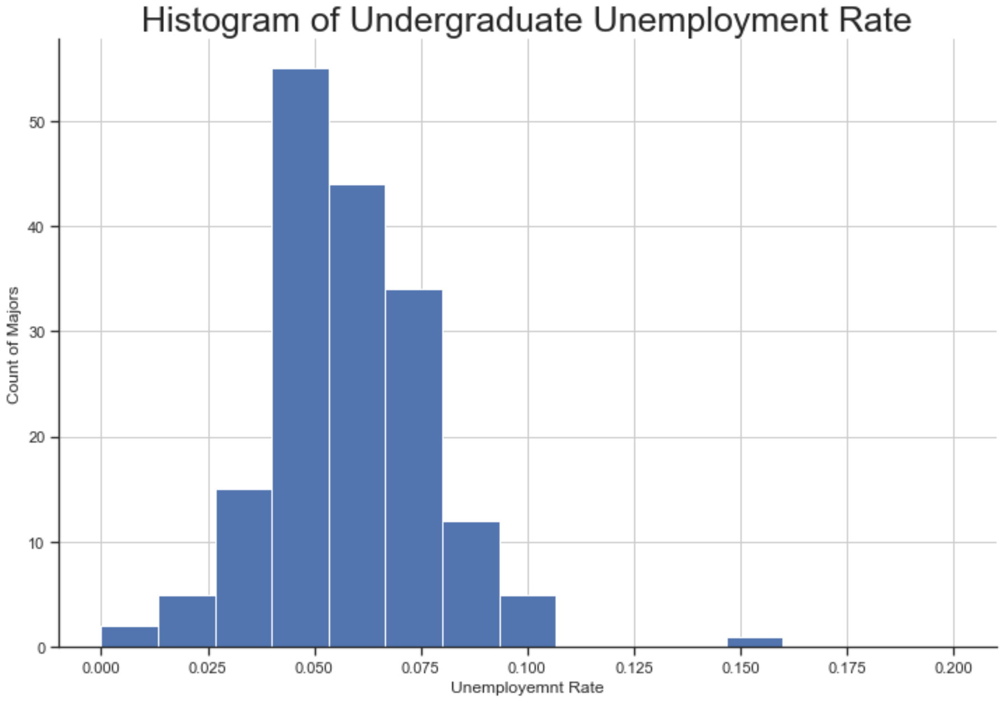
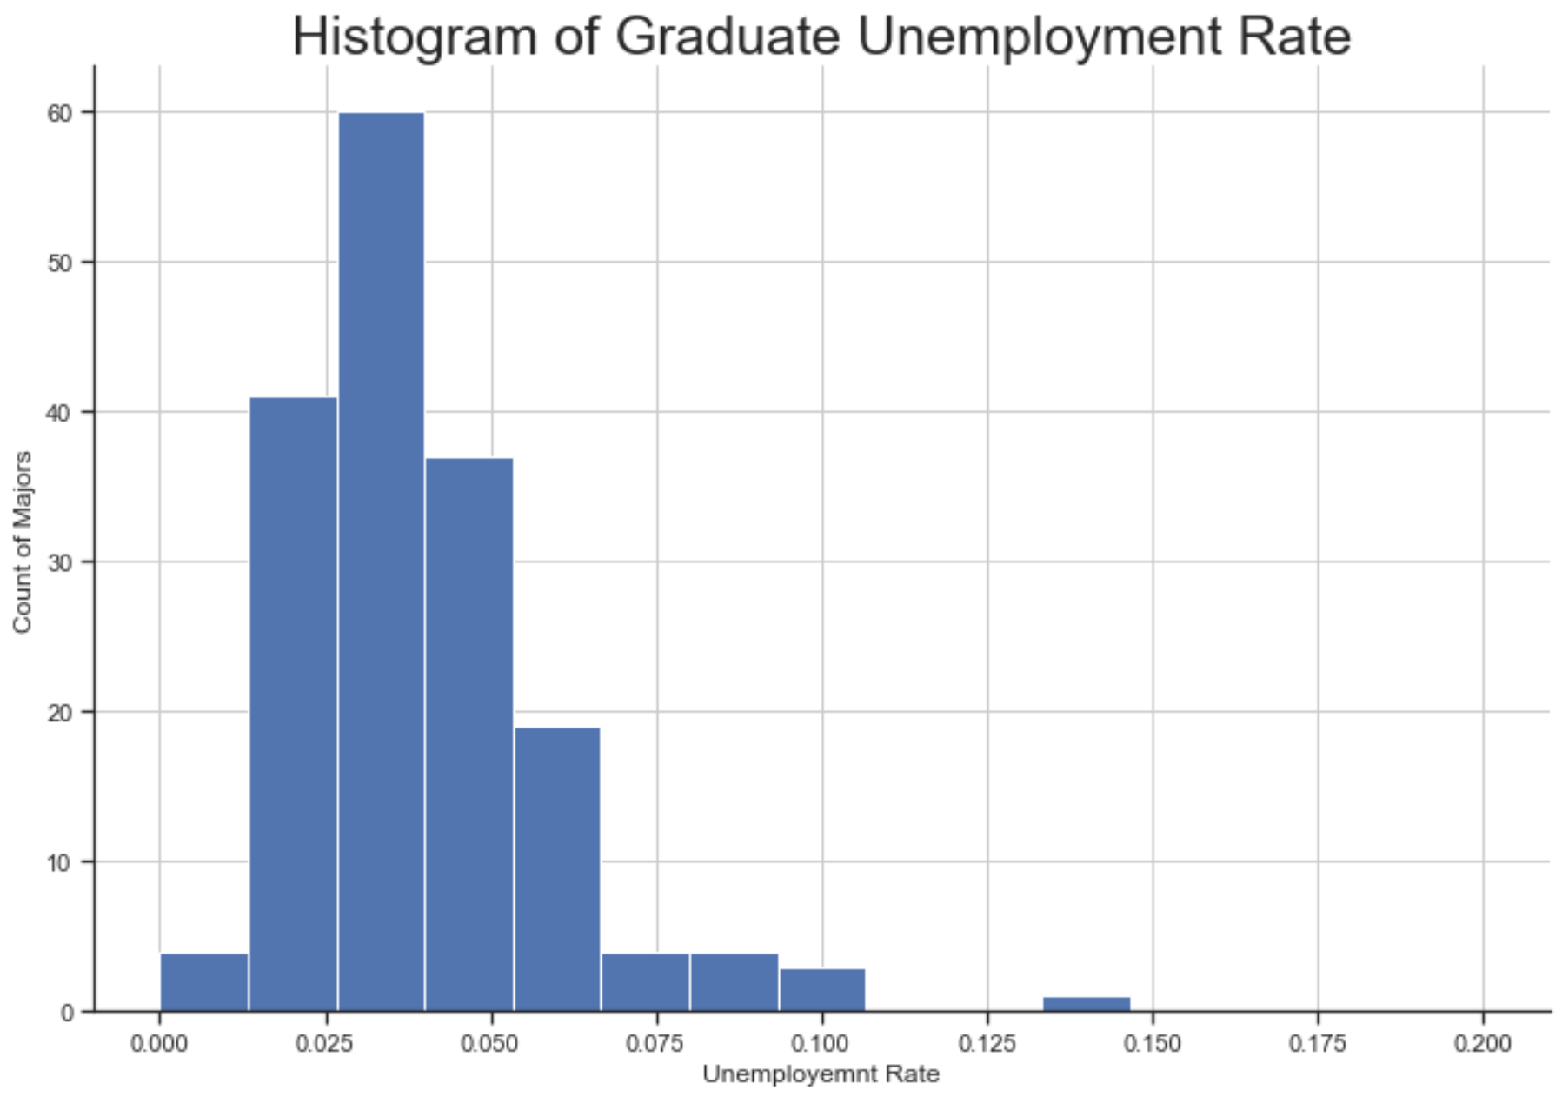
ANALYSIS OF UNEMPLOYMENT RATE

Slide 13
Hypothesis Testing
Run a paired samples t-test on the equality of means
Null Hypothesis: µ1 = µ2, or the average unemployment rates are equal
Alternative Hypothesis: µ1 ≠ µ2, or the average unemployment rates are not equal
Alpha level: 0.05
First, we must check the paired samples t-test assumptions that the distribution of the two groups follows a normal distribution

Slide 14
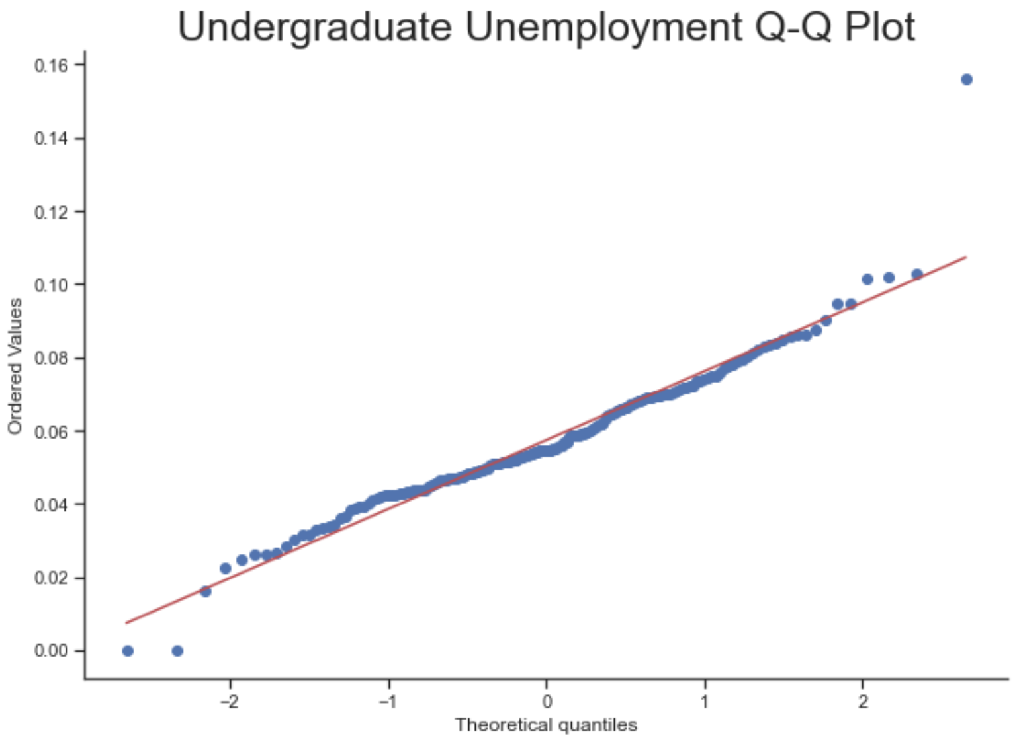
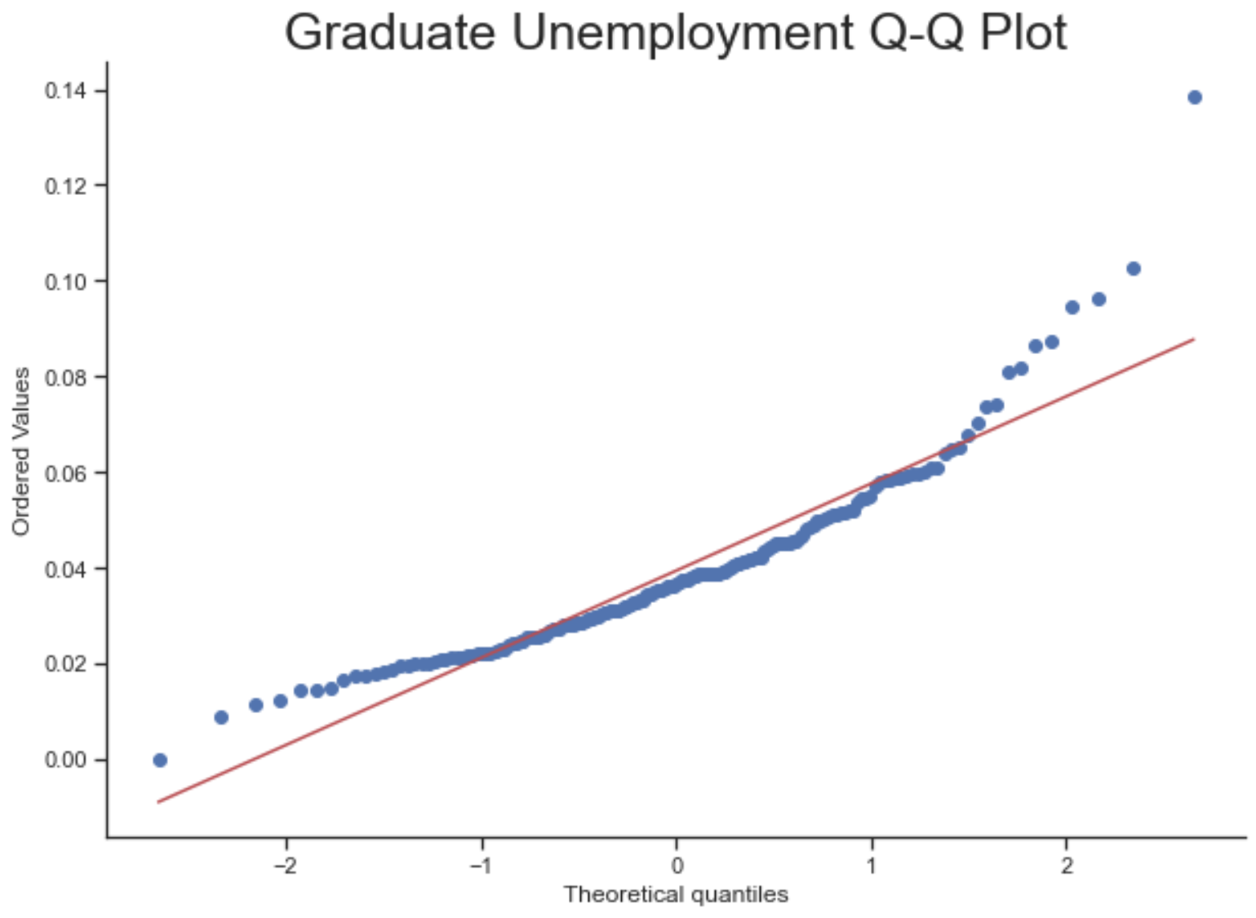
Check for normality

Slide 15
Running the paired t-test
Used stats.ttest_rel() from the stats package in Pyhton
P-value = 0.000
Since the p-value is less than the selected alpha level of 0.05, we reject the null hypothesis, and we can conclude that there is a statistically significant difference in the average unemployment rates earned by workers with a graduate degree and those with just an undergraduate degree.

Slide 16
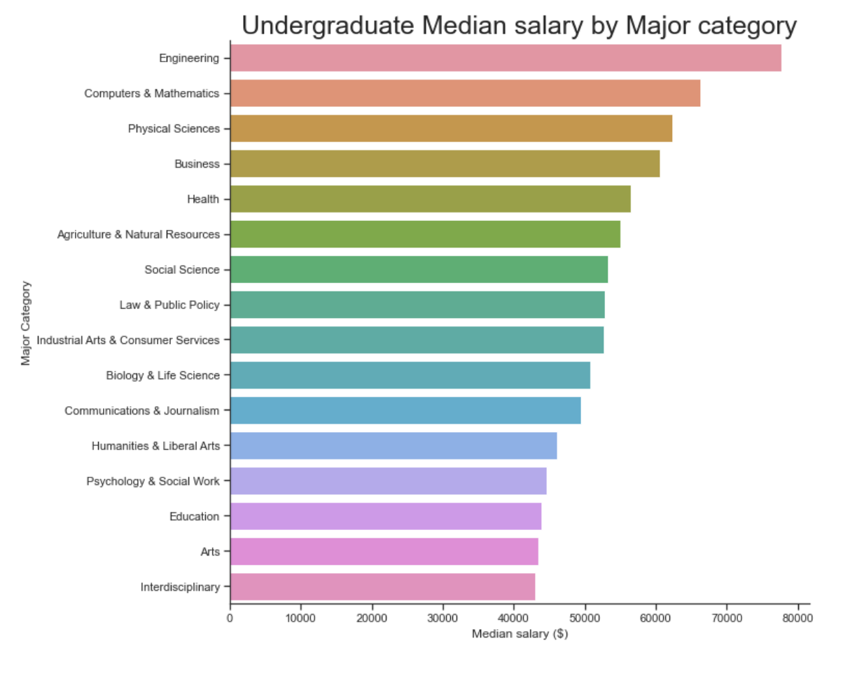
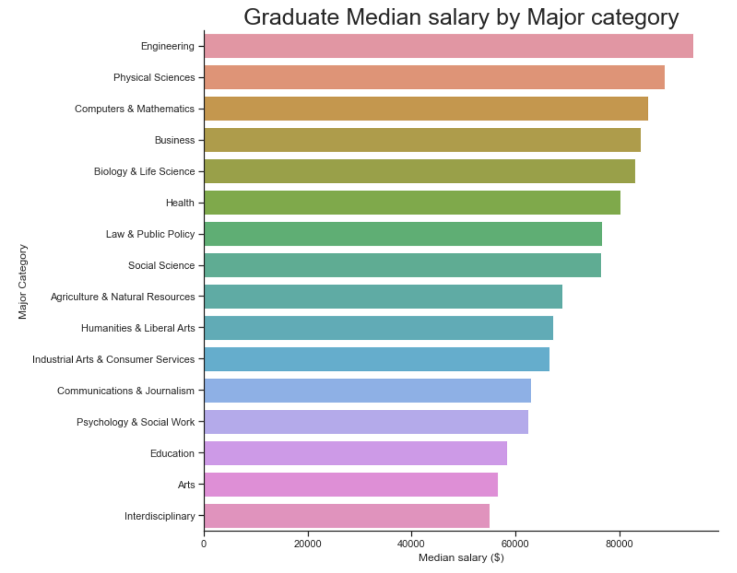
benefits by major category

Slide 17
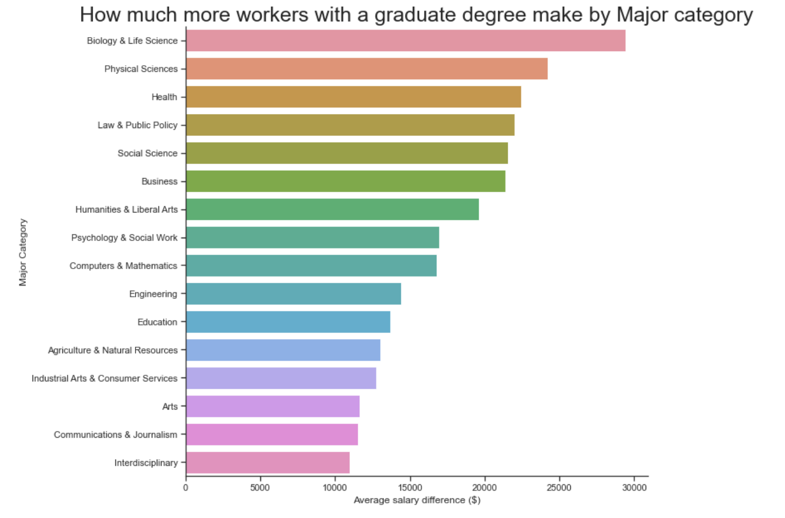
BENEFITS BY MAJOR CATEGORY

Slide 18
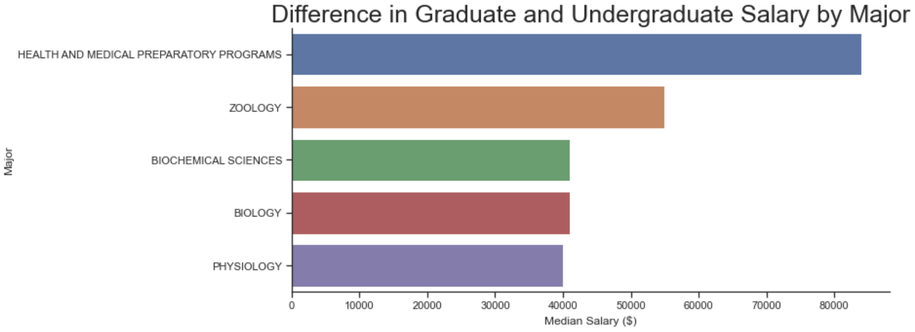
Best graduate degrees

Slide 19
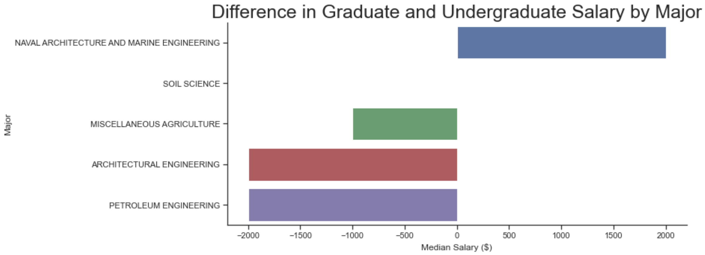
Worst graduate degrees

Slide 20
conclusions
There is a significant benefit in both salary and employment for workers with a Graduate degree.
However, there are certain majors where a graduate degree is much less beneficial and majors where a graduate degree is nearly required.

